Slide 1
Mid Semester Presentation
on
Project
SOLAR POWERED WATER TRASH COLLECTOR
SUBJECT CODE-MTR-401
Session: July- December 2021
Presented by:
PRAKASH & AVINASH
18BEM1003 & 18BEM1016
Project Supervisor
Mr. Inderpreet Singh
Designation-Asst. Prof
UIE-Department of Mechatronics Engineering

Slide 2
Contents
Introduction
Literature Review
Review Analysis and Research Gap
Project Objectives (Novelties if any… )
Experimental Setup/Procedure (H/W AND S/W→Block Diagram, Components, Design and Circuit or Protoype Snapshots)
Work plan or Division/ Timeline
Present Work done (Work by each Team Member)
Pending Work
References
UIE-Department of Mechatronics Engineering

Slide 3
Introduction
This Project aims to design a Solar Powered water trash collector.
This system will work on the principle of wireless controlling of Arduino using mobile application.
The proposed system consists of a Conveyor belt which is constantly running ,Arduino based electronics ,Bluetooth connectivity and Mobile application controlling of whole setup.
Installed with a trash collector below the conveyor belt and for stability of whole setup in water air filled tube is installed below it.
UIE-Department of Mechatronics Engineering
Department of Mechatronics Engineering

Slide 4
Literature review
S.No. | Author(s) | Type/Title of study
1 | Ketan H. Pakhmode, Ronit R. Dudhe, Gangadhar S. Waghmare, Daniyal A. Kamble, Kirti Dhenge(2019) | Solar powered water surface garbage collecting boat
2 | K.P.M.Y.V.Dathu, M.Monish Kumar, V.Kartheek, M.M.Karunakar (2019) | Design of River Waste Collector Machine Using Arduino
3 | N.Kiran Kumar, G.Vivek, Dr.A.Pulla Reddy (2018) | Bluetooth based Garbage Collection Robot using Arduino Microcontroller.
4 | M. Mohamed Idhris , M. Elamparthi, C. Manoj kumar, Dr.N.Nithyavathy, Mr. K. Suganeswaran, Mr. S. Arunkumar(2017) | Design and fabrication of remote controlled sewage cleaning machine
UIE-Department of Mechatronics Engineering

Slide 5
Review Analysis
In the above mentioned papers mostly they have shown how we can design a garbage collector in rivers.
In 1st paper they proposed a solar powered garbage collector base only .
In 2nd paper they designed a garbage collector using Arduino and in 3rd paper they installed Bluetooth for controlling the garbage collector mainly.
In 4th paper they had designed and fabricated the river trash collector So, our project is basically the combination of all these projects which will float on water and collect trash from ponds effectively.
UIE-Department of Mechatronics Engineering

Slide 6
Research Gap
In all the above mentioned Papers none of them used feature such as :
Use of mobile application to control the movement of boat and manipulation of direction of boat.
Using solar power to control remotely the boat.
It has a physically installed conveyor belt which helps in the collection of trash from the river surface.
Combination of all the previously formed designes and fabricated in a new manner.
UIE-Department of Mechatronics Engineering

Slide 7
Project Objectives
Remotely controlled boat type structure.
Use of conveyor belt to collect the trash effectively.
Withstand up to 10kg load of trash at a single time.
Android application is used for movement of boat structure and to establish connectivity between Bluetooth and application.
Cheaper in case of smaller ponds and water bodies as it can be handled with ease by anyone.
UIE-Department of Mechatronics Engineering

Slide 8
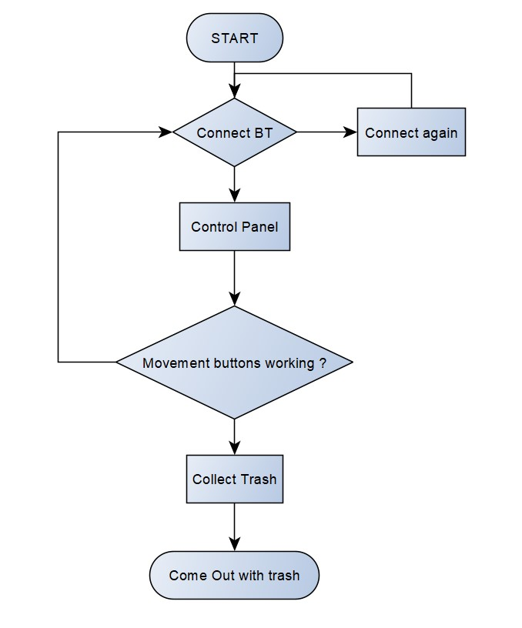
Experimental Setup/Procedure
UIE-Department of Mechatronics Engineering

Slide 9
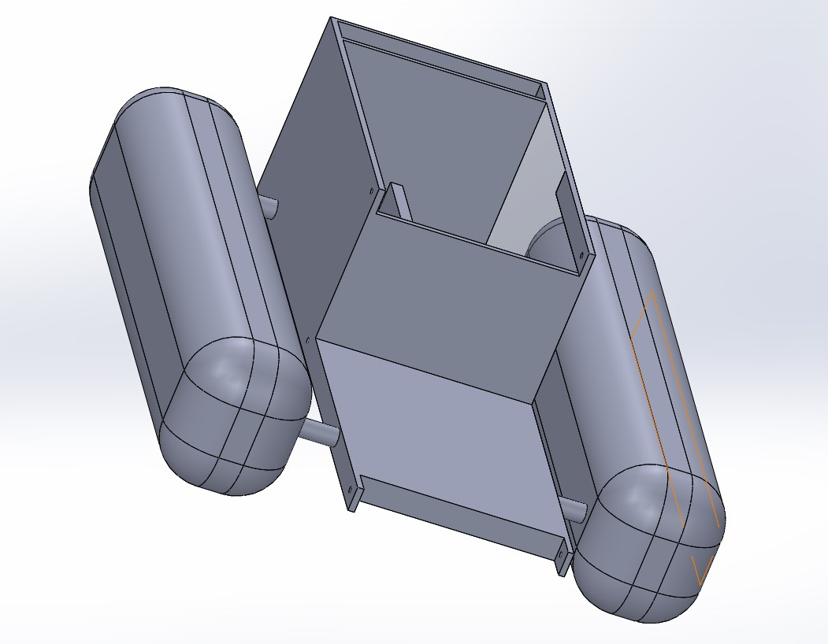
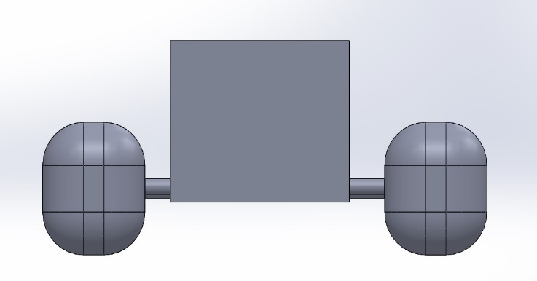
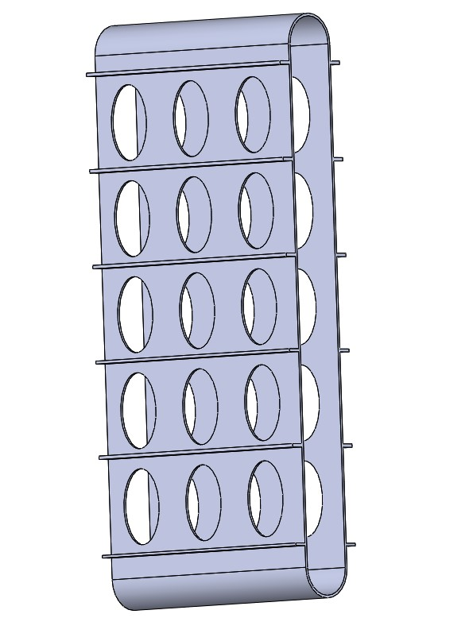
CAD Diagram
Back View
Isometric View
Conveyor

Slide 10
Components
S. No | Components | Price (INR)
1. | Arduino Uno R3 | 350
2. | Bluetooth Module | 200
3. | 30rpm motors *2 | 550
4. | Solar plate | 600
5. | Battery | 700
Software Used
IDE – Arduino MIT App Inventor
Mechanical Frame
PVC boat structure with Conveyor belt
UIE-Department of Mechatronics Engineering

Slide 11
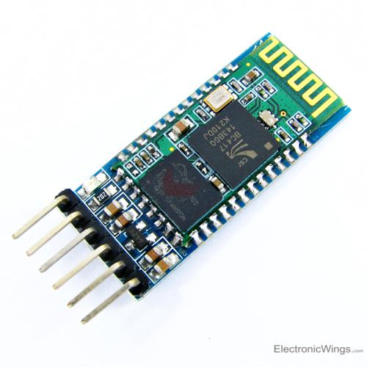
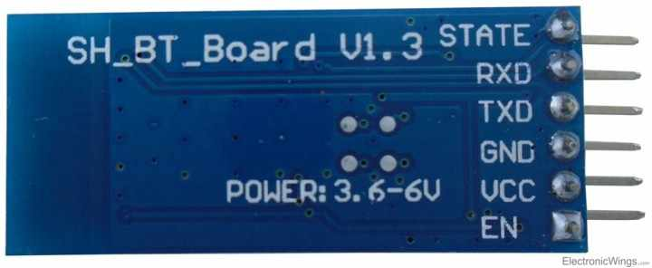
HC-05 Bluetooth Module
FEATURES :-
It is used for many applications like wireless headset, game controllers, wireless mouse, wireless keyboard and many more consumer applications.
It has range up to <100m which depends upon transmitter and receiver, atmosphere, geographic & urban conditions.
It is IEEE 802.15.1 standardized protocol, through which one can build wireless Personal Area Network . It uses frequency-hopping spread spectrum radio technology to send data over air.
It uses serial communication to communicate with devices. It communicates with microcontroller using serial port (USART).

Slide 12
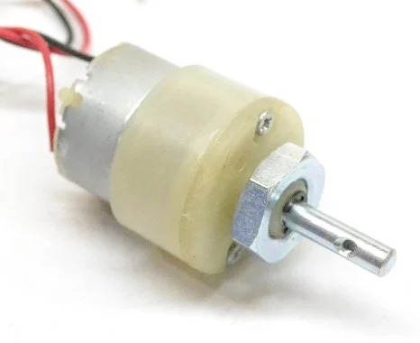
30 RPM 12V DC Motor
FEATURES
DC Motor – 30RPM – 12Volts can be used in all-terrain robots and a variety of robotic applications.
These motors have a 3 mm threaded drill hole in the middle of the shaft thus making it simple to connect it to the wheels or any other mechanical assembly.
Rated Speed (RPM) | 30
Operating Voltage (VDC) | 12
Rated Torque(kg-cm) | 5

Slide 13
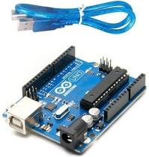
Aurduino UNO R3 And Specifications
Microcontroller | ATmega328P
Operating Voltage | 5V
Input Voltage (recommended) | 7-12V
Input Voltage (limit) | 6-20V
Digital I/O Pins | 14 (of which 6 provide PWM output)
PWM Digital I/O Pins | 6
Analog Input Pins | 6
DC Current per I/O Pin | 20 mA
DC Current for 3.3V Pin | 50 mA
Flash Memory | 32 KB (ATmega328P) of which 0.5 KB used by bootloader
SRAM | 2 KB (ATmega328P)
EEPROM | 1 KB (ATmega328P)
Clock Speed | 16 MHz
LED_BUILTIN | 13
UIE-Department of Mechatronics Engineering

Slide 14
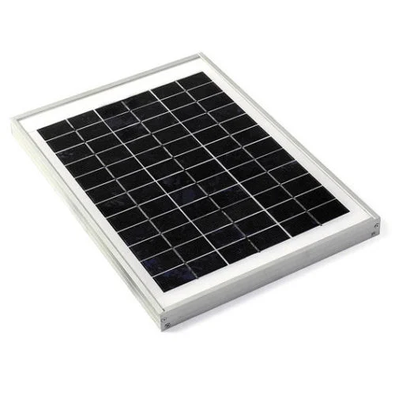
Solar Plate with battery
FEATURES
5 Watt 12 V Polycrystalline
Type of Product : | Polycrystalline Solar Panel
Rated Power Range : | 1-30 W
Watt : | 5 W
Voltage at Pmax ( V) : | 17.3 V
Module Voltage : | 12 V
UIE-Department of Mechatronics Engineering

Slide 15
Work Plan and Division
S.No. | NAME OF TEAM MEMBER | WORK ALLOCATED TO EACH TEAM MEMBER
1. | Prakash Kumar Mandal | Programming , Hardware designing & Prototype makings
2. | Avinash Kumar | Literature Review , Report writing
Work Plan | Time span
Selection of project based on real life problem | 1-09-2021 to 7-09-2021
Selection of components and purchasing | 01-10-2021 to 20-10-2021
Learning required modules | 7-09-2021 to 20-09-2021
Deploying of code on system and testing working of prototype | 25-10-2021 to 30-10-2021
Troubleshooting and report writing | 1-11-2021 to 20-11-2021
UIE-Department of Mechatronics Engineering

Slide 16
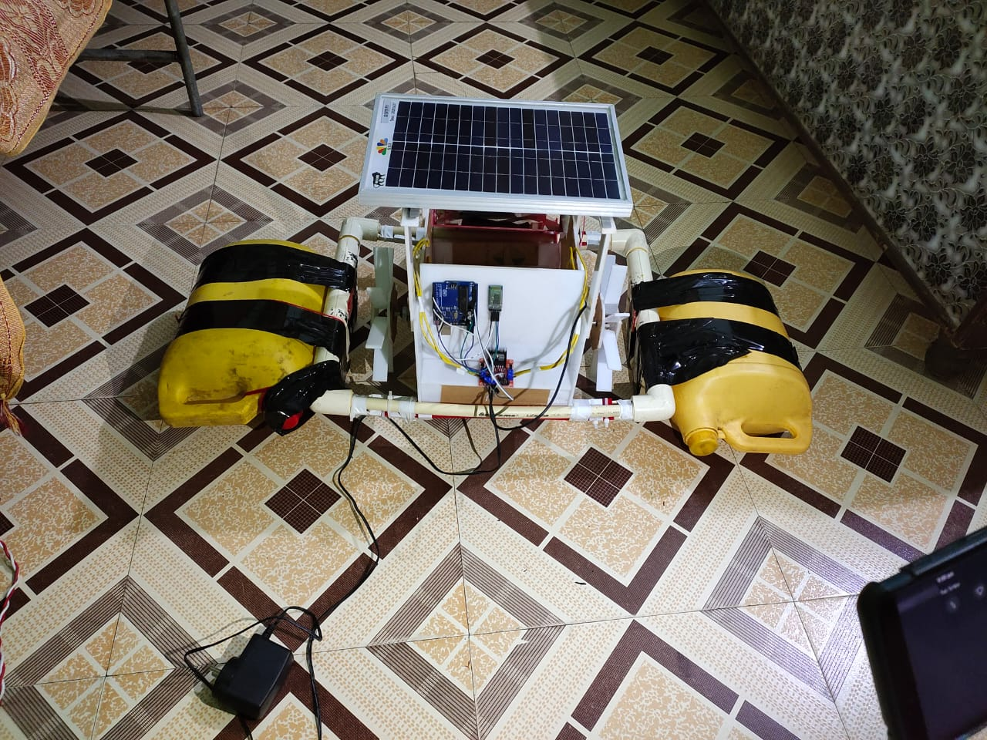
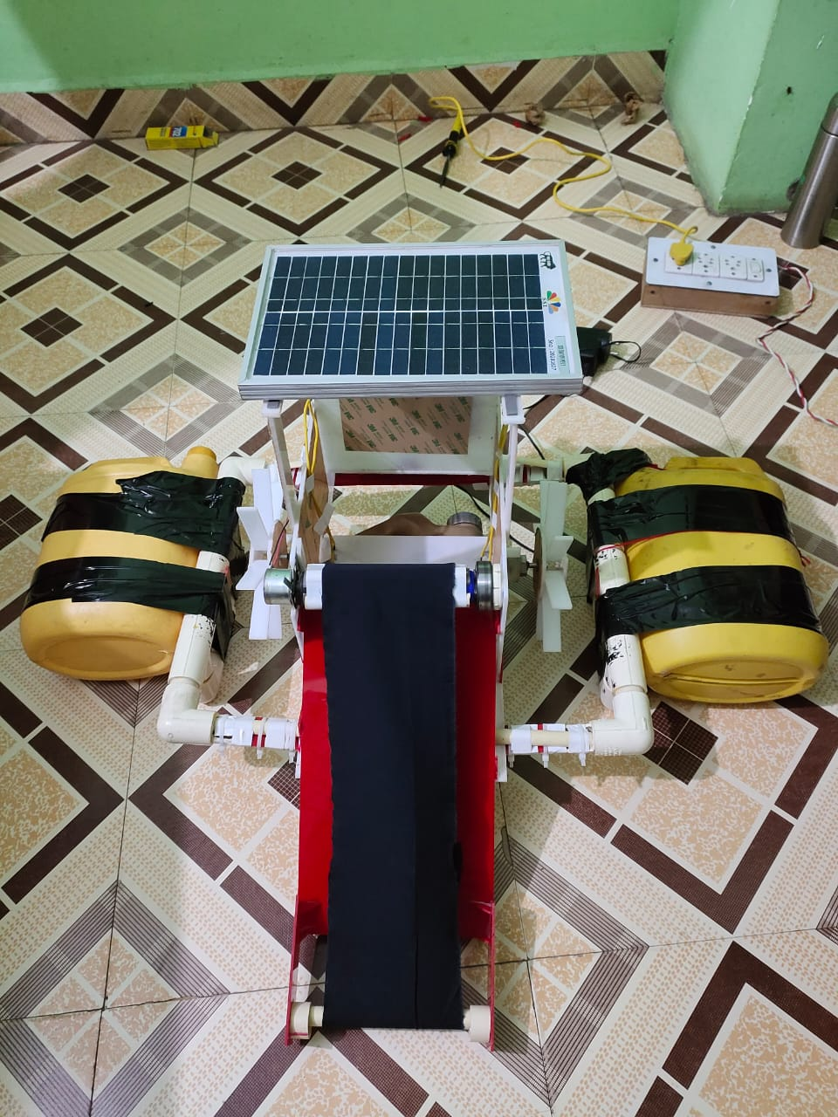
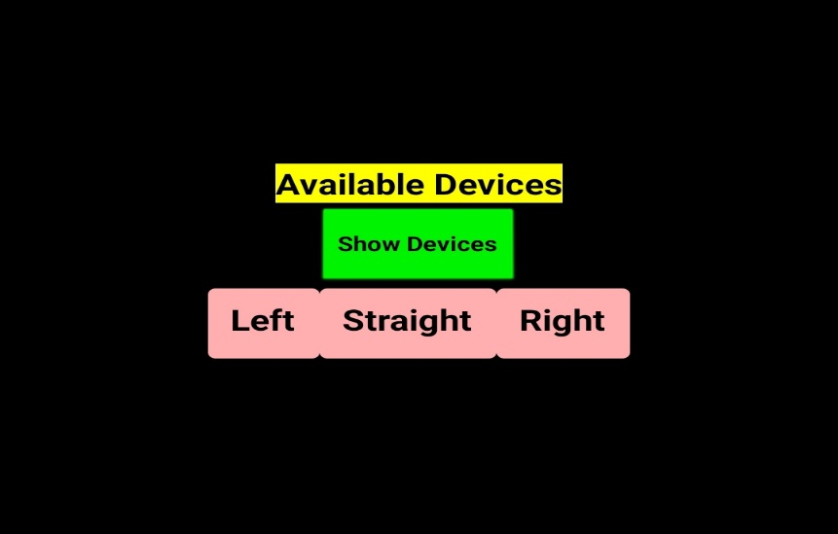
RESULT
UIE-Department of Mechatronics Engineering

Slide 17
References
[1] K.P.M.Y.V.Dathu,M.Monish Kumar, V.Kartheek, M.M.Karunakar Design of River Waste Collector Machine Using Arduino 2019 ; www.ijrar.org (E-ISSN 2348-1269, P- ISSN 2349-5138)
[2] Atharva Hasabnis , Rohit Lokhande , Tushar Naik, Aishwarya Avhad, Dr.M.V.Nagarhalli Design & Fabrication of Automatic River Cleaning Machine Using Arduino and Mobile Control 2020; e-ISSN: 2319-8753, p-ISSN: 2320-6710 www.ijirset.com Impact Factor: 7.512
[3] Ketan H. Pakhmode, Ronit R. Dudhe, Gangadhar S. Waghmare, Daniyal A. Kamble,Kirti Dhenge SOLAR POWERD WATER SURFACE GARBAGE COLLECTING BOAT 2019; e-ISSN: 2395-0056 p-ISSN: 2395-0072 Mar 2019 www.irjet.net.
[4] N.Kiran Kumar, G.Vivek, Dr.A.Pulla Reddy Bluetooth based Garbage Collection Robot using Aurduino 2018 ; www.jetir.org (ISSN-2349-5162).
[5] Sunil, J. & Thomson, M & Abiram, A & Jenish, G & Jenish, L. (2021). Design and Development of Unmanned River Water Trash Collector. International Journal of Scientific Research in Science and Technology. 9. 122-126. 10.32628/IJSRST219117.
[6] Serafia, Andrea-Bianca & Santos, António & Caddia, Davide & Zeeman, Evelien & Castaner, Laura & Malheiro, Benedita & Ribeiro, Cristina & Justo, Jorge & Silva, Manuel & Ferreira, Paulo & Guedes, Pedro. (2021). Floating Trash Collector - An EPS@ISEP 2020 Project.
UIE-Department of Mechatronics Engineering
UIE-Department of Mechatronics Engineering

